Slide 1

Python SQL

Slide 2
What is SQL?
SQL stands for Structured Query Language
SQL lets you access and manipulate databases

Slide 3
What Can SQL do?
SQL can execute queries against a database
SQL can retrieve data from a database
SQL can insert records in a database
SQL can update records in a database
SQL can delete records from a database
SQL can create new databases
SQL can create new tables in a database
SQL can create stored procedures in a database
SQL can create views in a database
SQL can set permissions on tables, procedures, and views

Slide 4
Common Technical terms used in SQL
PRIMARY KEY
The PRIMARY KEY constraint uniquely identifies each record in a table.
Primary keys must contain UNIQUE values, and cannot contain NULL values.
A table can have only ONE primary key; and in the table, this primary key can consist of single or multiple columns (fields).

Slide 5
FOREIGN KEY
A FOREIGN KEY is a key used to link two tables together.
A FOREIGN KEY is a field (or collection of fields) in one table that refers to the PRIMARY KEY in another table.
The table containing the foreign key is called the child table, and the table containing the candidate key is called the referenced or parent table.

Slide 6
Look at the following two tables:
"Persons" table:
PersonID | LastName | FirstName | Age
1 | Hansen | Ola | 30
2 | Svendson | Tove | 23
3 | Pettersen | Kari | 20
"Orders" table:
OrderID | OrderNumber | PersonID
1 | 77895 | 3
2 | 44678 | 3
3 | 22456 | 2
4 | 24562 | 1

Slide 7
Notice that the "PersonID" column in the "Orders" table points to the "PersonID" column in the "Persons" table.
The "PersonID" column in the "Persons" table is the PRIMARY KEY in the "Persons" table.
The "PersonID" column in the "Orders" table is a FOREIGN KEY in the "Orders" table.
The FOREIGN KEY constraint is used to prevent actions that would destroy links between tables.
The FOREIGN KEY constraint also prevents invalid data from being inserted into the foreign key column, because it has to be one of the values contained in the table it points to.

Slide 8
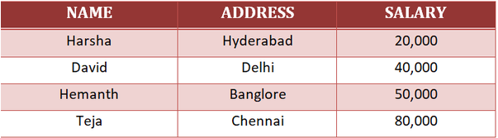
Tables : In Relational database model, a table is a collection of data elements organized in terms of rows and columns. A table is also considered as a convenient representation of relations. Table is the simplest form of data storage. Below is an example of an Employee table.

Slide 9
Python can be used in database applications.
One of the most popular databases is MySQL.
MySQL Database
To be able to experiment with the code examples in this tutorial, you should have MySQL & MySQL Connector installed on your computer.

Slide 10

Test MySQL Connector To test if the installation was successful, or if you already have "MySQL Connector" installed, create a Python page with the following content:
Note:
If the above code was executed with no errors, "MySQL Connector" is installed and ready to be used.

Slide 11
Create
Create Connection :
Start by
Start by creating a connection to the database.
Use
Use the username and password from your MySQL database:

Slide 12
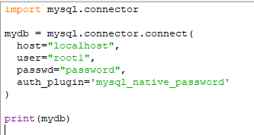

CODE:
OUTPUT:

Slide 13
The MySQLCursor of mysql-connector-python (and similar libraries) is used to execute statements to communicate with the MySQL database.
Using the methods of it you can execute SQL statements, fetch data from the result sets, call procedures.
You can create Cursor object using the cursor() method of the Connection object/class.

Slide 14
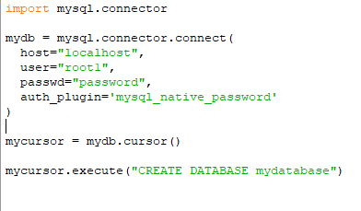
Creating a Database
To create a database in MySQL, use the "CREATE DATABASE" statement:

Slide 15
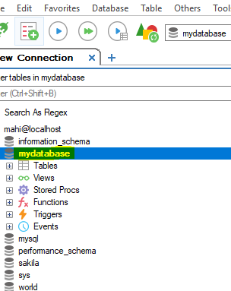
OutPut:

Slide 16
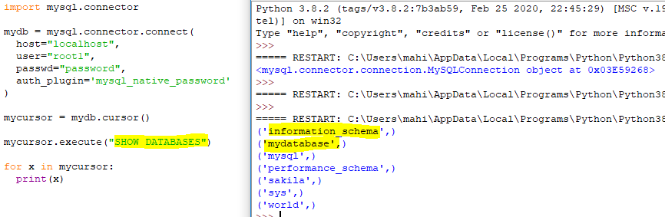
Check if Database Exists:
You can check if a database exist by listing all databases in your system by using the "SHOW DATABASES" statement:

Slide 17
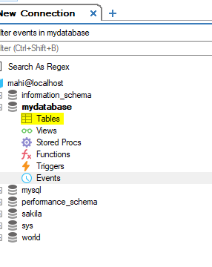
Creating a Table :
To create a table in MySQL, use the "CREATE TABLE" statement.
Make sure you define the name of the database when you create the connection
In this example : table does not contain any data

Slide 18
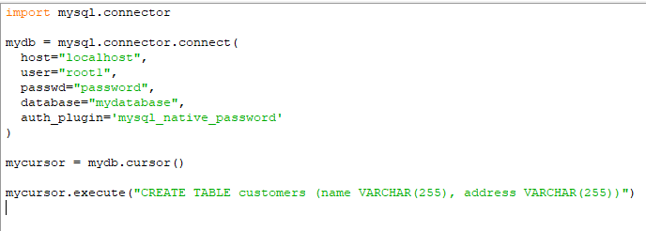
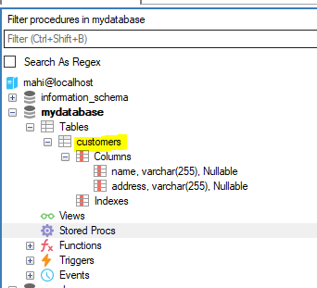
CODE :
OUTPUT:

Slide 19
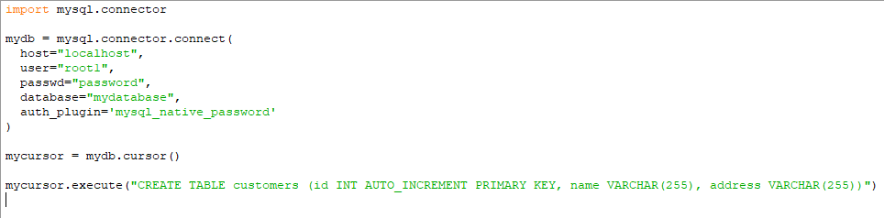
Primary Key :
When creating a table, you should also create a column with a unique key for each record.
This can be done by defining a PRIMARY KEY.
We use the statement "INT AUTO_INCREMENT PRIMARY KEY" which will insert a unique number for each record. Starting at 1, and increased by one for each record.

Slide 20
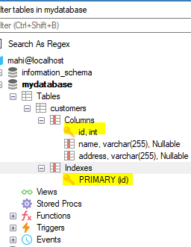
DB OUTPUT:
Insert Into Table
To fill a table in MySQL, use the "INSERT INTO" statement.

Slide 21
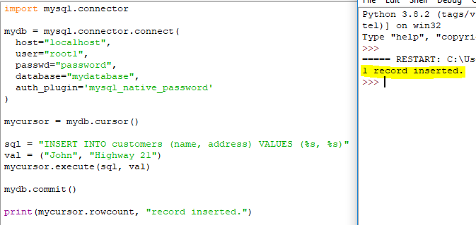
Important!: Notice the statement: mydb.commit(). It is required to make the changes, otherwise no changes are made to the table.

Slide 22
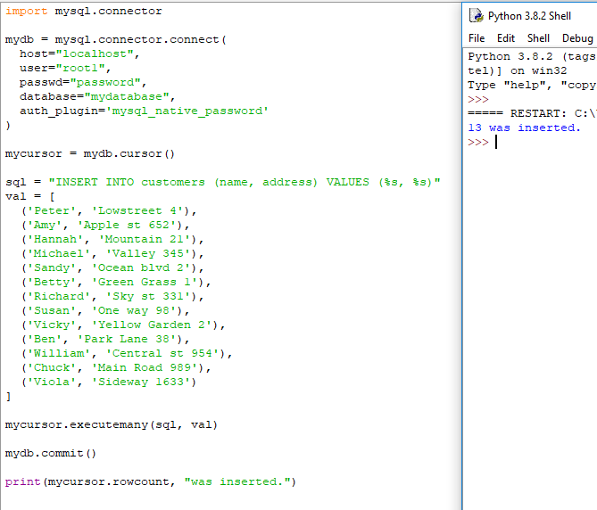
Insert Multiple Rows
To insert multiple rows into a table, use the executemany() method.
The second parameter of the executemany() method is a list of tuples, containing the data you want to insert:

Slide 23
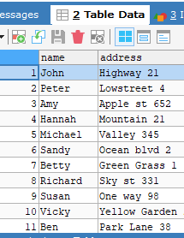
DB OUTPUT:
Get Inserted ID
You can get the id of the row you just inserted by asking the cursor object.
Note: If you insert more that one row, the id of the last inserted row is returned.

Slide 24
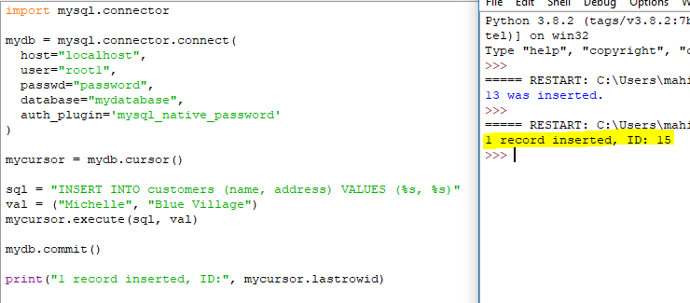

Slide 25
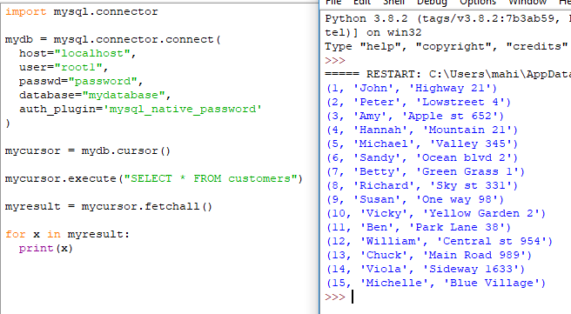
Select From a Table
To select from a table in MySQL, use the "SELECT" statement:
Example
Select all records from the "customers" table, and display the result:

Slide 26
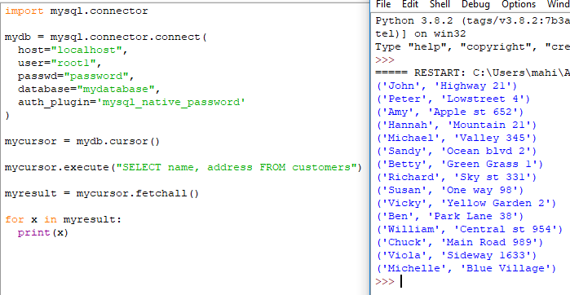
Note: We use the fetchall() method, which fetches all rows from the last executed statement.
Selecting Columns
To select only some of the columns in a table, use the "SELECT" statement followed by the column name(s):
Example
Select only the name and address columns:

Slide 27
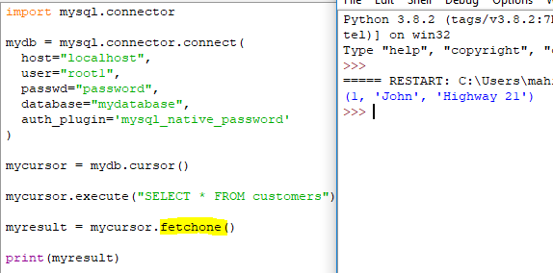
Using the fetchone() Method
If you are only interested in one row, you can use the fetchone() method.
The fetchone() method will return the first row of the result:
Example
Fetch only one row:

Slide 28
Python MySQL Where
Select With a Filter
When selecting records from a table, you can filter the selection by using the "WHERE" statement:
Example
Select record(s) where the address is "Park Lane 38": result:

Slide 29
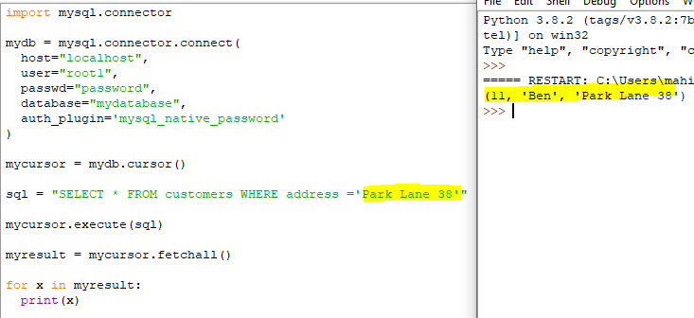

Slide 30
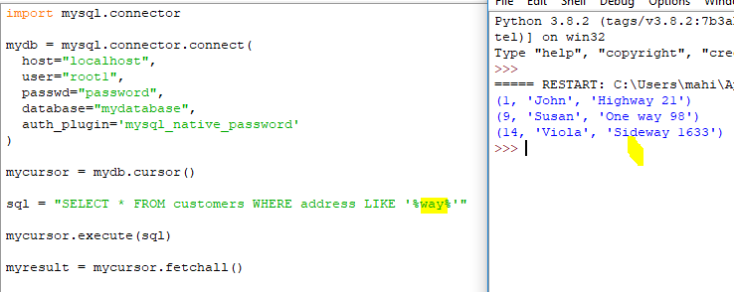
Wildcard Characters
You can also select the records that starts, includes, or ends with a given letter or phrase.
Use the % to represent wildcard characters:
Example
Select records where the address contains the word "way":

Slide 31

SQL Injection
SQL injection is a code injection technique that might destroy your database.
SQL injection is one of the most common web hacking techniques.
SQL injection is the placement of malicious code in SQL statements, via web page input.
SQL injection usually occurs when you ask a user for input, like their username/userid, and instead of a name/id, the user gives you an SQL statement that you will unknowingly run on your database.
Look at the following example which creates a SELECT statement by adding a variable (txtUserId) to a select string. The variable is fetched from user input (getRequestString):

Slide 32
Prevent SQL Injection
When query values are provided by the user, you should escape the values.
This is to prevent SQL injections, which is a common web hacking technique to destroy or misuse your database.
The mysql.connector module has methods to escape query values:
Example
Escape query values by using the placholder %s method:

Slide 33
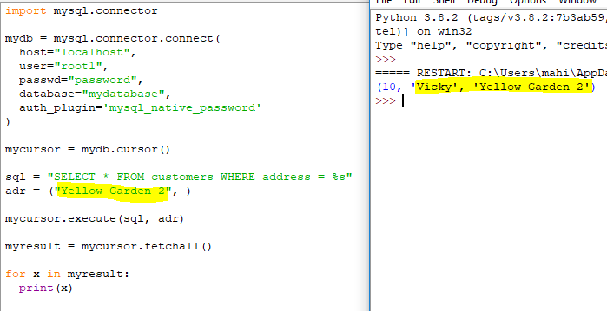

Slide 34

Thank You

